Slide 1

October 12, 2019

Slide 2
Question: How do teams fare in the next game after playing the dominant team?
Are teams with better records more likely to beat the dominant team? Are they more likely to win the next game?
Has playing the dominant team changed their odds in the next game?
Data & Methodology
Kaggle Database of 11 European Soccer Leagues along with their EA Sports’ FIFA players’ ratings and results of 25k matches from 2008 to 2016.
Tables include Country, Leagues, Matches, Players, Player Attributes, Team Attributes
Focused on 2015-16 season, which was most recent in database. Could easily have looked at earlier seasons.

Slide 3
database.sqlite
Kaggle
Jupyter Notebook
import sqlite3
conn = sqlite3.connect('database.sqlite')
DataFrame Object
COUNTRY_df = pd.read_sql_query("select * from COUNTRY;", conn)

Slide 4
database.sqlite
Kaggle
Jupyter Notebook
import sqlite3
conn = sqlite3.connect('database.sqlite')
DataFrame Object
COUNTRY_df = pd.read_sql_query("select * from COUNTRY;", conn)

Slide 5
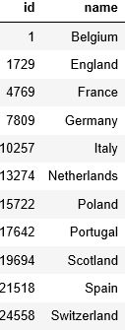
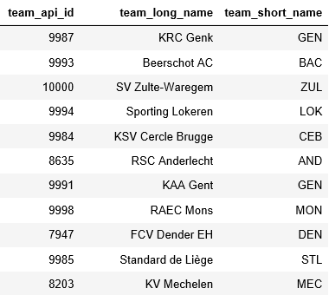
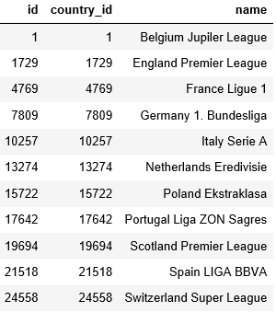
COUNTRY
TEAM
LEAGUE

Slide 6
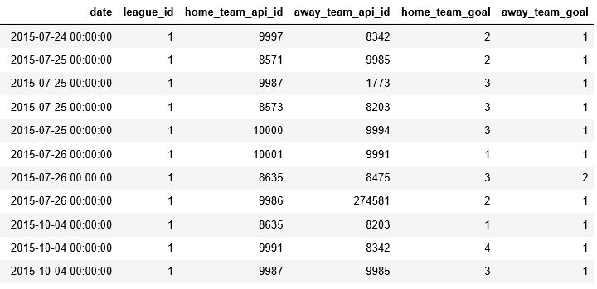
MATCH

Slide 7
For every game against Dominant team …
Team’s
game 1
Dominant Team
… what happened in the next game?
Team’s
game 2
Some other team
Win Loss or Tie? By how much?

Slide 8
Split out Home And Away Games
MATCH
HOME_df
AWAY_df

Slide 9
HOME_df
AWAY_df
home_team_goal - away_team_goal
DIFF
away_team_goal - home_team_goal
ALL GAMES
frames = [HOME, AWAY]
pd.concat(frames)

Slide 10
The tricky part - getting the next game: Step 1 – Copy and sort the data
Do not use:
next_game = all_games 🡨 Would make a new “nickname” for all_game
It does not male a new dataframe
Changes to next_game would apply to all_game
Use:
next_game = all_games.copy()🡨 Makes a new copy of next_game
Can change each dataframe independently

Slide 11
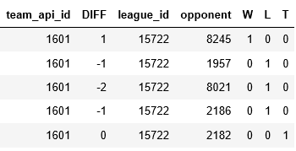
Step 2 – Shift the data to see two consecutive games in one row
next_game
all_games
df_complete = pd.merge(all_games, next_game.shift(-1).fillna(0), left_index=True, right_index=True)
Select 332 rows with game against Dominant Team and Next Game

Slide 12
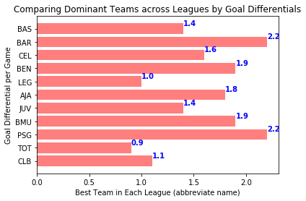

Slide 13
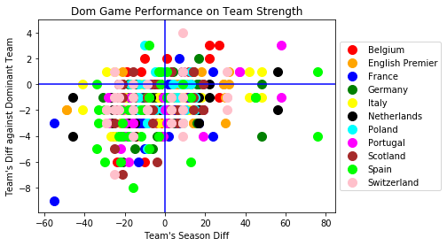

Slide 14
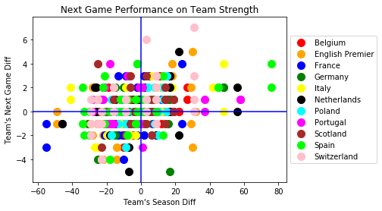

Slide 15
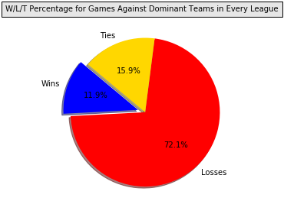
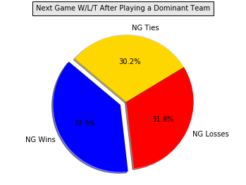
W/L/T against Dominant Team and in the Following Game

Slide 16
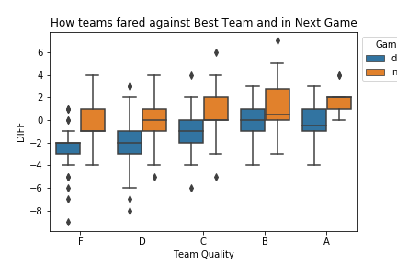
Teams’ Performance against Dom & in Next Game

Slide 17
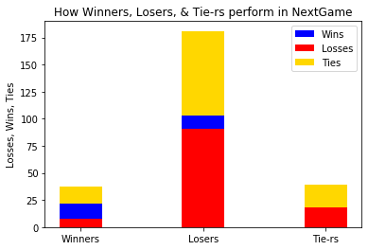
s (pie chart)

Slide 18
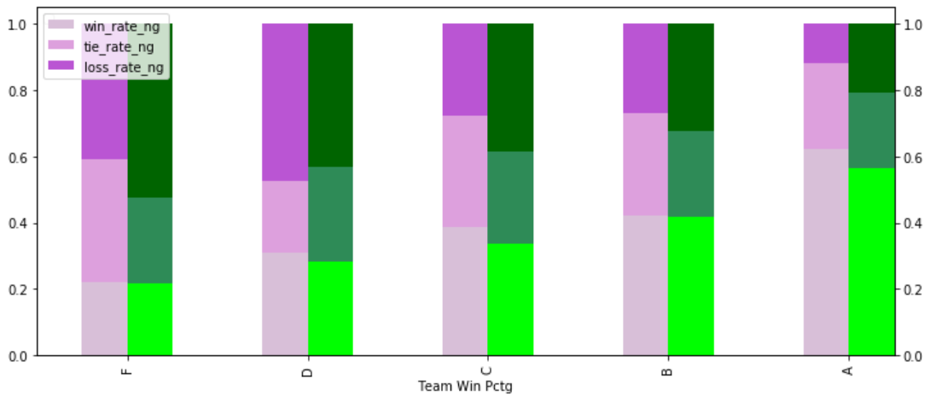
Season winning % (purple) Vs Next Game winning % (green)
Compared to the entire season, teams did slightly worse in the next game
Bottom bar shows the wins – top show the losses

Slide 19
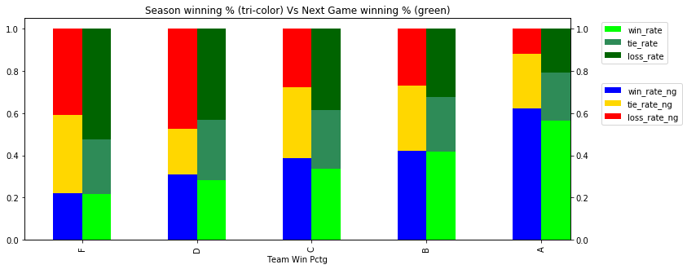

Slide 20
What we should/could have done
Compare outcome in next game vs odds in next game based on two teams’ diff’s
Histogram for team winning percentages (skewed vs. normal distribution for Major League Baseball)
Could have used multiple seasons
Used additional dimensions (time of possession) for team quality including for the best team

